Slide 1


Secure Coding Practices for Python Web Applications
This presentation focuses on identifying and mitigating common security vulnerabilities in Python web applications. We will review a Flask-based web application example for task management. We will use tools like Bandit, a static code analyzer, and manual code review to discover security flaws and prevent future issues.
by Vijay Andra

Slide 2

Introduction to Python Web Application Security
Web application security risks are always present. We will provide an overview of common vulnerabilities in Python web apps based on the OWASP Top 10. These include injection flaws, broken authentication, sensitive data exposure, XML External Entities (XXE), broken access control, and security misconfiguration.
Injection Flaws
Broken Authentication
(SQL, Command Injection)
Cross-Site Scripting (XSS)

Slide 3
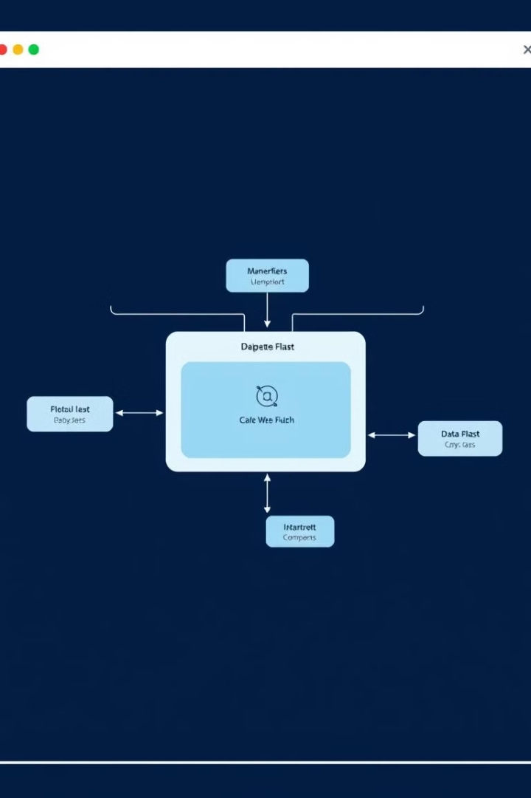
Case Study: Task Management Application Overview
Our case study is a Flask-based application. Its key components include user authentication, task creation and management, and database interaction using SQLAlchemy. We will focus on these areas in our security review to understand vulnerabilities. The goal is to identify security flaws, fix them and prevent them in the future.
User Authentication
Task Management
Handling user credentials.
Creating and organizing tasks.
Database Interaction
(SQLAlchemy)

Slide 4




Static Code Analysis with Bandit
Bandit is a tool for static code analysis. It helps find security issues automatically. Bandit can identify hardcoded passwords, use of eval() or exec(), and insecure temporary file usage. Understanding severity levels is important for prioritizing fixes.
Configuration
Setting up Bandit for your project.
Usage
Running Bandit to scan code.
Severity Levels
Understanding alert importance.

Slide 5
Manual Code Review: Identifying Vulnerabilities
Manual code review is important. Here are some key areas to examine: SQL Injection, Cross-Site Scripting (XSS), and Command Injection. Look for un-parameterized queries, un-escaped user input, and use of os.system() with user-controlled input.
SQL Injection
Cross-Site Scripting (XSS)
Un-parameterized queries
Un-escaped user input in templates

Slide 6

Secure Coding Practices: Input Validation and Sanitization
Always validate user input on both client and server sides. Sanitize input to remove or escape potentially malicious characters. Use regular expressions for validation. Use escaping functions in templates like escape() in Jinja2 to prevent XSS.
1
Client-Side Validation
2
Server-Side Validation
3
Sanitization

Slide 7






Secure Coding Practices: Authentication and Authorization
Enforce strong password policies: require minimum length, complexity, and regular updates. Hash passwords with bcrypt or Argon2. Implement proper access control mechanisms like Role-Based Access Control (RBAC). Avoid storing sensitive information in cookies or local storage.
Hashing
Strong Passwords
Access Control

Slide 8
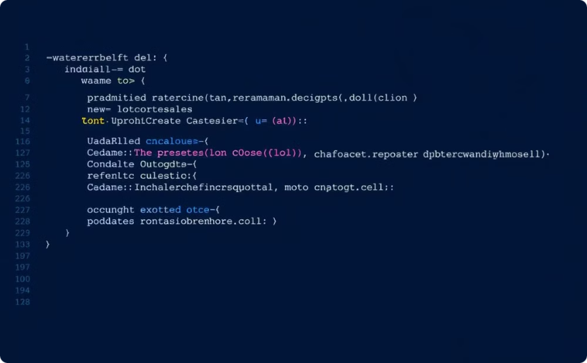

Secure Coding Practices: Database Security
Use parameterized queries to prevent SQL injection. Apply the Principle of Least Privilege. Only grant necessary permissions to database users. Follow ORM best practices for security with SQLAlchemy. Avoid raw SQL queries when possible.
Parameterized Queries
Principle of Least Privilege

Slide 9
Secure Coding Practices: Security Headers and Configuration
Set security headers to mitigate common attacks. These include X-Frame-Options, X-XSS-Protection, Content-Security-Policy, and Strict-Transport-Security. Keep dependencies up-to-date. Disable debug mode in production for better protection.
1
Security Headers
2
Dependency Updates
3
Disable Debug Mode

Slide 10

Conclusion: Building a Security-First Mindset
Continuous security testing and code review are essential. Integrate security into the development lifecycle (DevSecOps). Use resources like OWASP, SANS Institute, and security-focused blogs. Security is an ongoing commitment, not a one-time fix.
OWASP
SANS
Web Security
Cyber Security

